Slide 1
Parallel Ray Tracing
Huiming Han
Zhiyuan Xu
Paden Tomasello
Chien-Yu Chiou

Slide 2
Outline
Problem and application
Algorithm
Pattern
Experiment and optimization
Final result
Future work
Conclusion

Slide 3
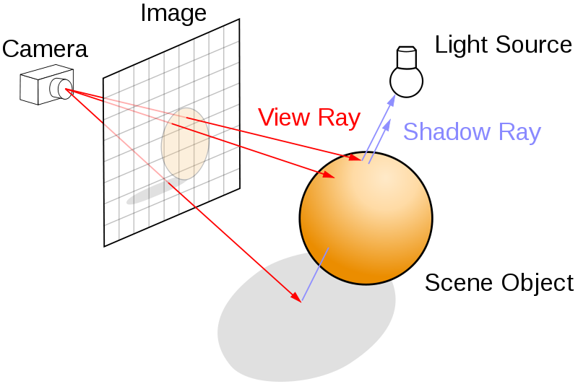
Trace the Ray
Generate realistic image with accurate lighting and shadow.
Real world: rays end at eye
Ray trace: rays from eye.
  Send ray from camera(eye)
  Intersect ray with object
  Send ray to light source
  If light blocked, shadow
  Lighting and Phong model for colors
  Reflections (recursive)

Slide 4
Outline
Problem and application
Algorithm
Pattern
Experiment and optimization
Final result
Future work
Conclusion

Slide 5
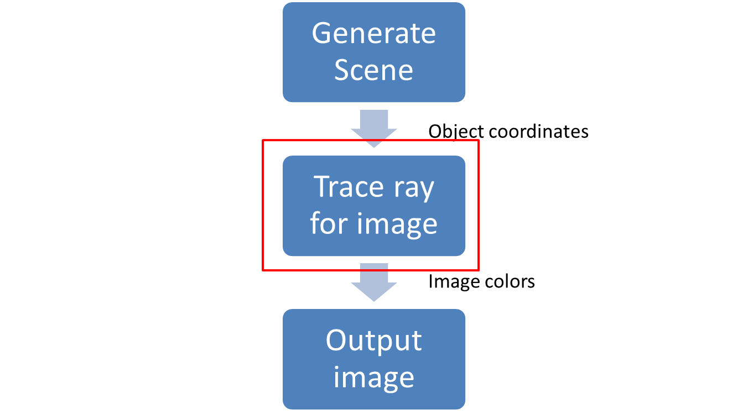
Program Flow

Slide 6
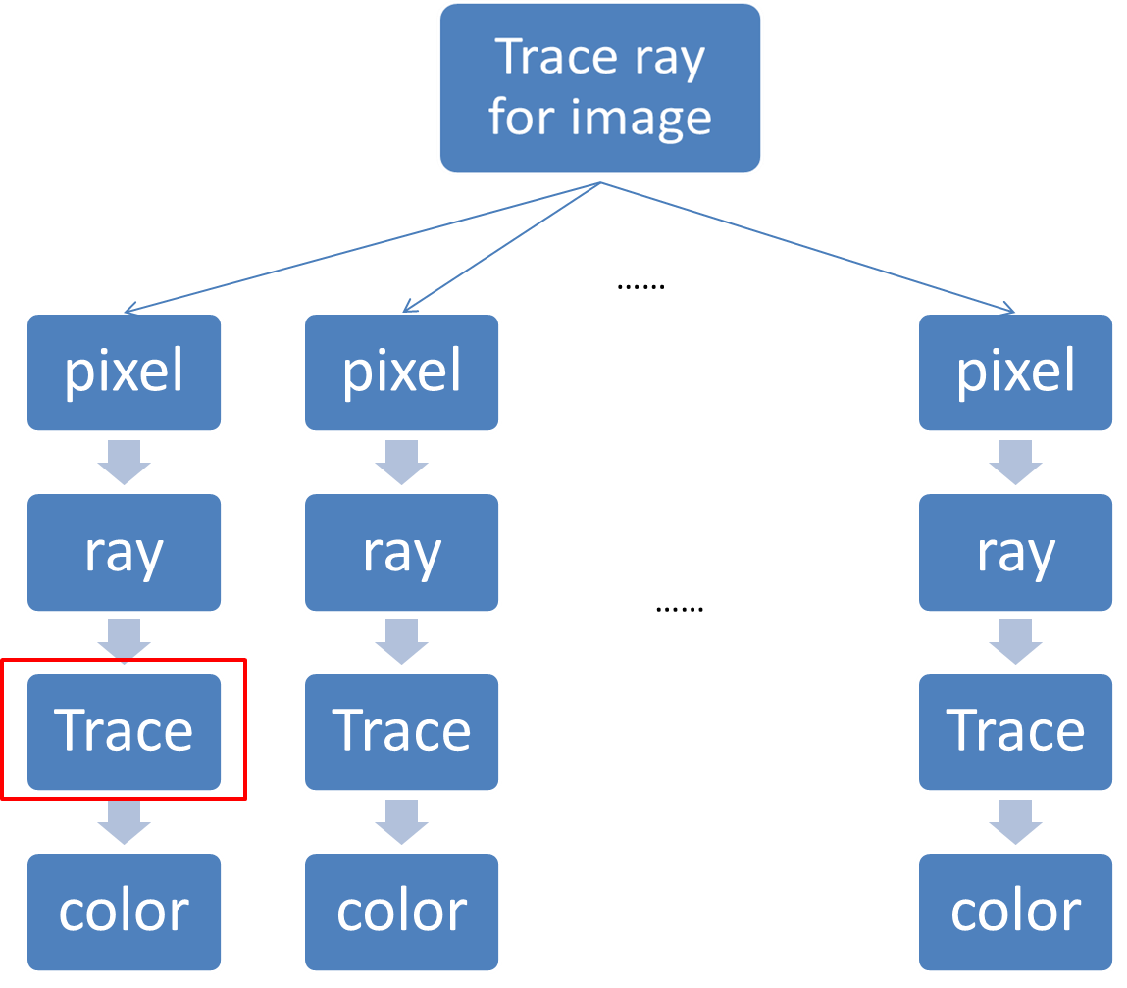

Slide 7
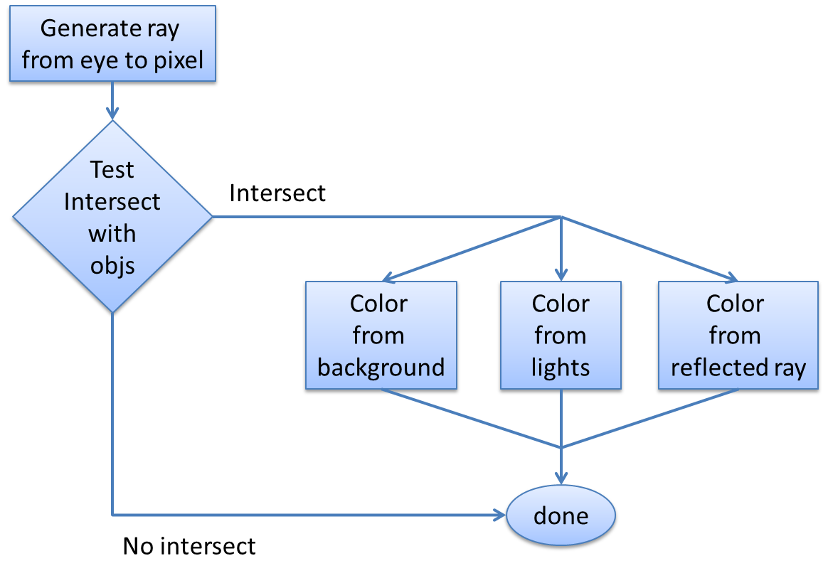
Every Single Pixel

Slide 8
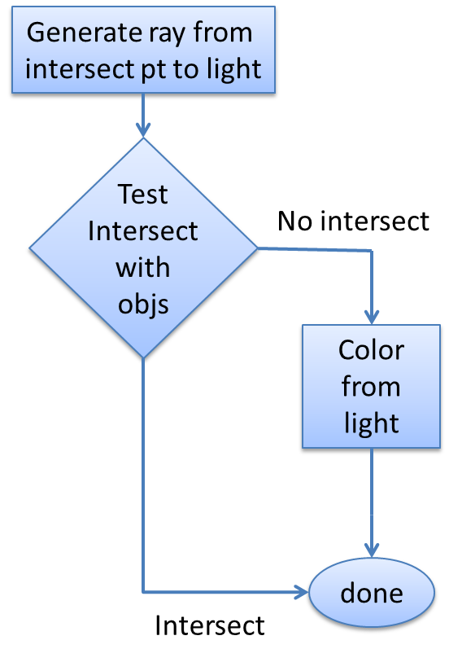
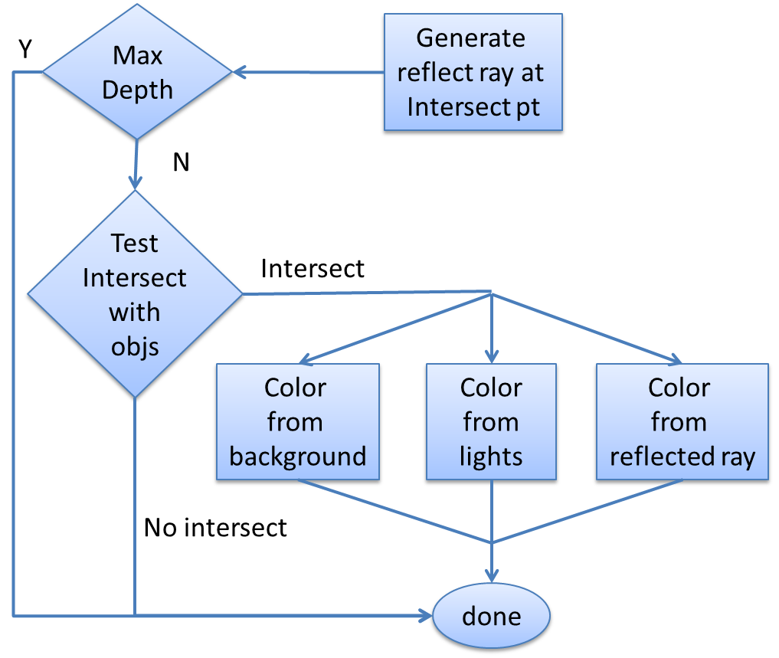
Color from Lights
Color from Reflected Ray

Slide 9
Key Computation

Slide 10
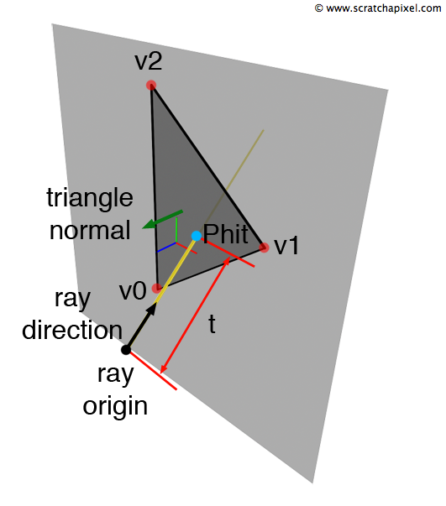
Key Computation
Ray–Triangle Intersection Tests
  Möller–Trumbore intersection algorithm.
Directly compute 3D -> Fast.
  Find ray-plane intersection point.
  Check if point in triangle

Slide 11
Outline
Problem and application
Algorithm
Pattern
Experiment and optimization
Final result
Future work
Conclusion

Slide 12
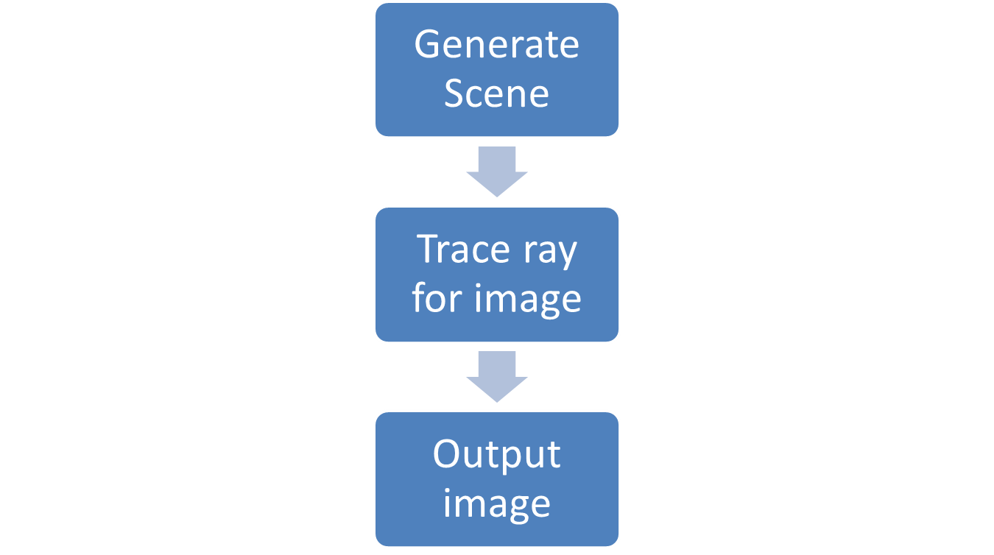
Pipe and Filter on Very Top LV

Slide 13
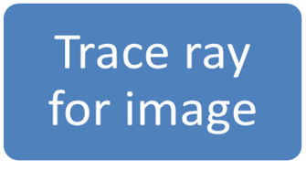
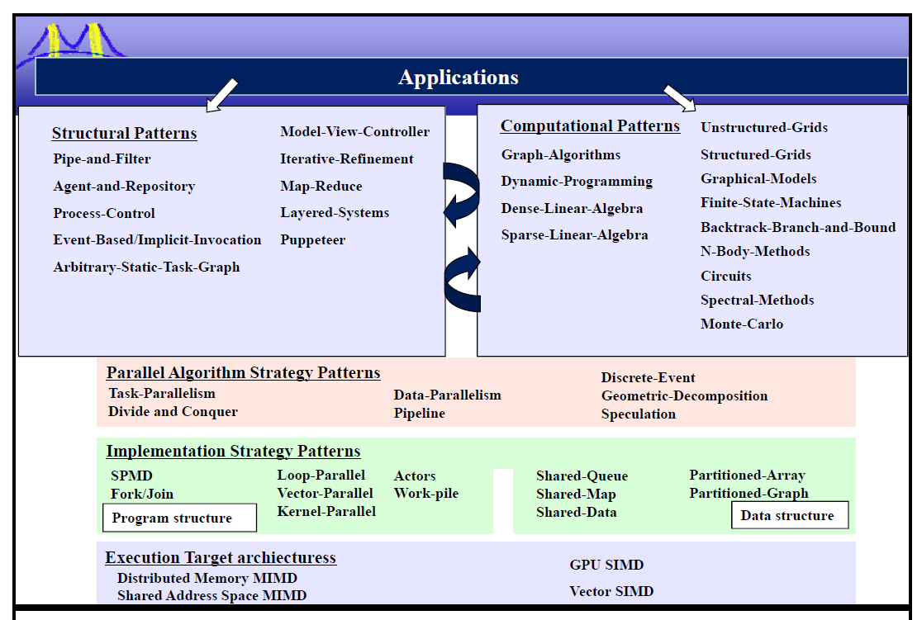
Notes:
Some rays end fast, some don’t
=> load imbalance
=> Task Parallelism

Slide 16
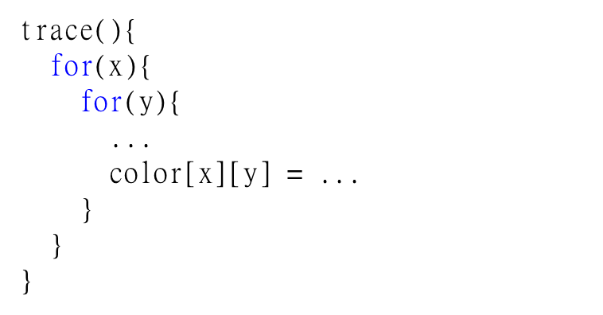

Slide 17
(x1, y1, z1)
+ (x2, y2, z2)

Slide 18
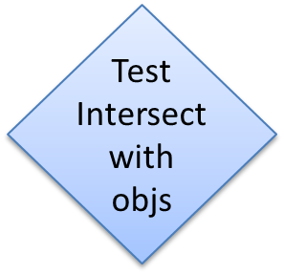

Slide 19
Outline
Problem and application
Algorithm
Pattern
Experiment and optimization
Final result
Future work
Conclusion

Slide 20
Hive machine
Dell T5500 Workstations
Dual-Socket Quad-Core Xeon X5620 2.4 GHz (Nehalem)
6 GB DDR3, 1067 MHz
Quadro FX 580 (Low-End 3D Graphics Card)
Nvidia Tesla C1060 GPU Compute unit

Slide 21
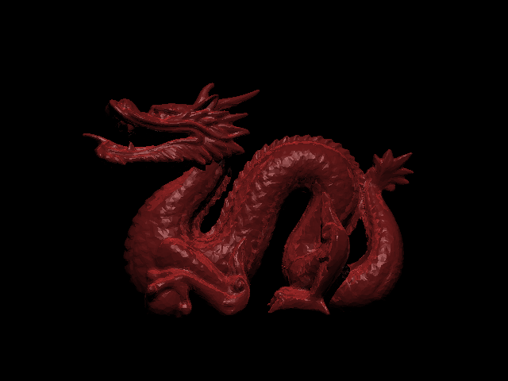
Stanford Dragon
Composed of 100,000 triangles

Slide 22
Serial Code
8 HR

Slide 23
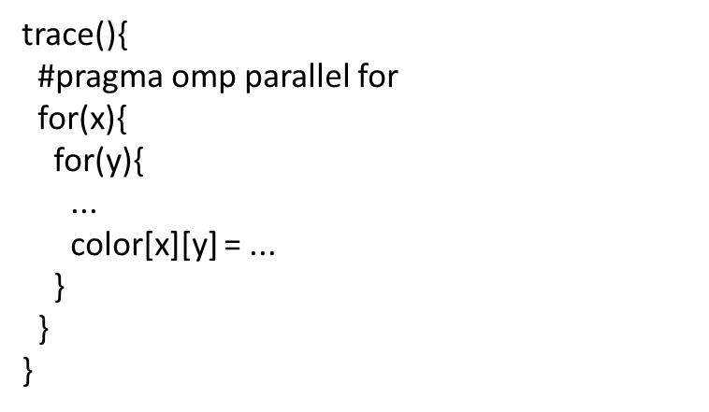
Parallel code with OpenMP
~ 57min

Slide 24
What can we do?
Specialization
Approximation
Multigrid/Successive refinement
Remove dynamic dependencies
Problem reformulation
Patch-up later
Speculation
Tweak-and-replicate
Memoization
Bounding
Removing redundant computation
Rethink target platform

Slide 25
Rethink Target Platform
GPU
  More suitable than CPU
  Code very different from serial code
  =>keep using CPU

Slide 26
What can we do?
Specialization
Approximation
Multigrid/Successive refinement
Remove dynamic dependencies
Problem reformulation
Patch-up later
Speculation
Tweak-and-replicate
Memoization
Bounding
Removing redundant computation
Rethink target platform

Slide 27
Reduce Intersection Test

Slide 28
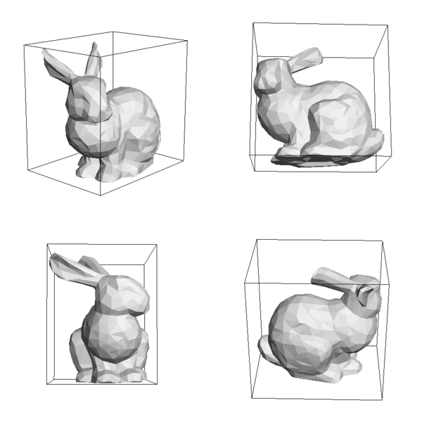
Bounding Boxes
Enclose neighboring shapes with bounding box
Ray intersect with shapes only if intersect with the bounding box
Easier to test intersection

Slide 29
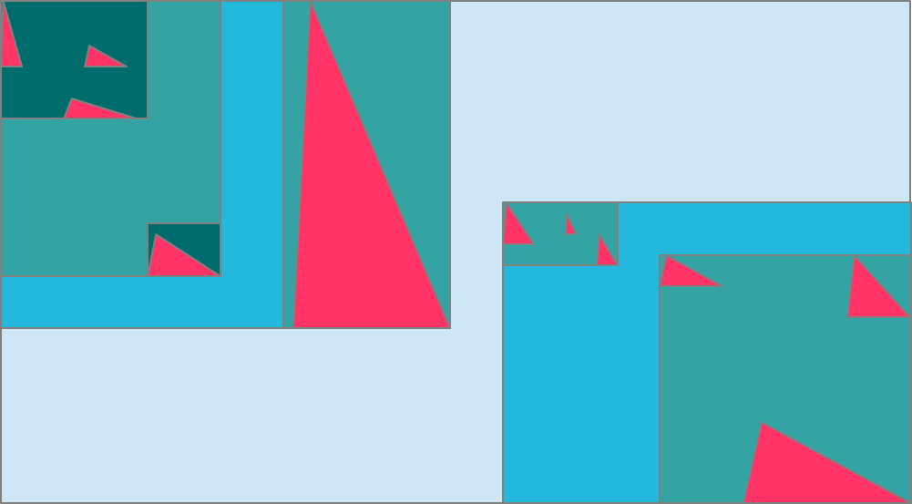
AABB Tree
Axis-Aligned Bounding Box Tree
Tree nodes are bounding boxes
Tree root encloses all shapes
Recursively partitioned by halves

Slide 30
AABB Tree
If a ray intersects a box, search the children
If no children, do ray-triangle intersection on contained shapes
Limits intersection tests to a few triangles
Similar to a quad-tree but in 3 dimensions

Slide 32
Other Optimization
Specialization
  Only consider triangle
Data Layout Transformation
  Store data in array instead of object
Approximation
  Change double to float
Removing redundant computation
  Pre-calculate normal vector of triangles
  Reduce computation of distance (square root)
SSE instruction

Slide 33
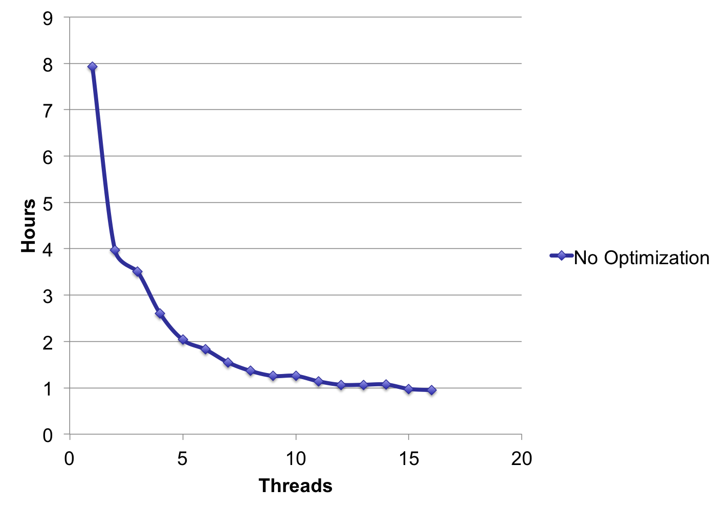
OpenMP Scale Plot
-Also tried omp task, too much overhead
-Use guided scheduler; progressively smaller chunks (some batches of rays require more computation than others)

Slide 34
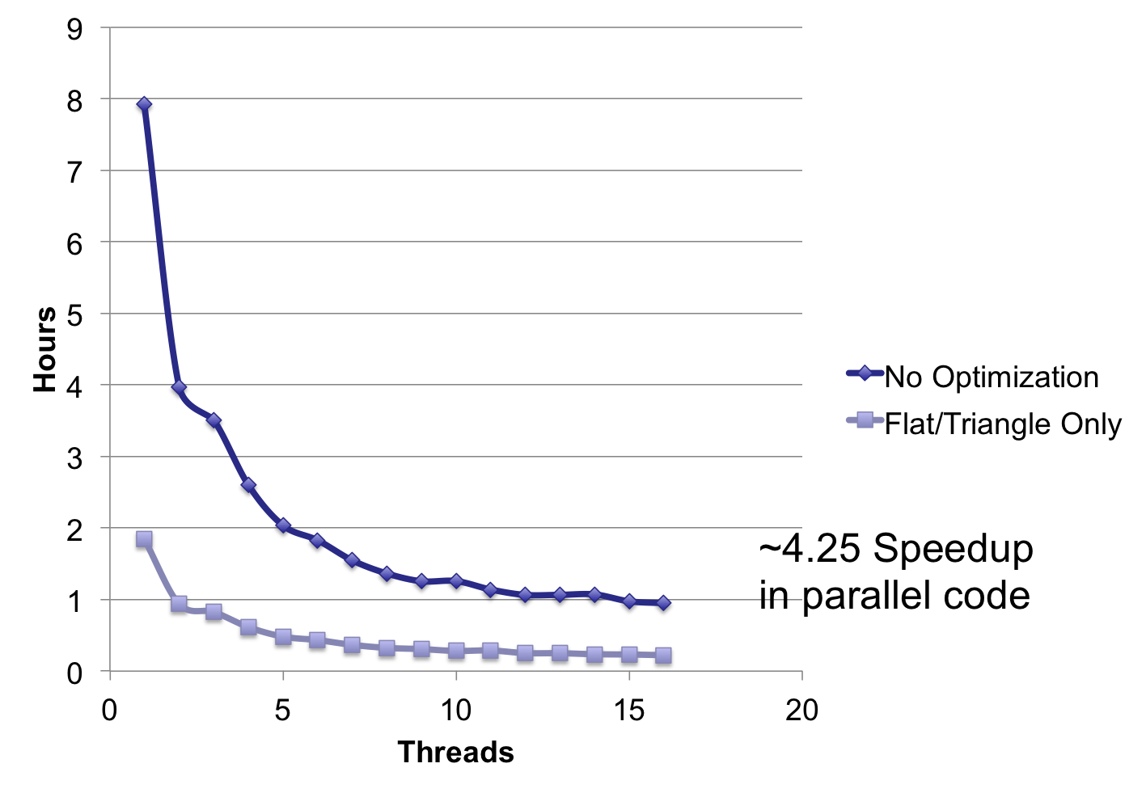
OpenMP Scale Plot
~4.3 speed up on serial code

Slide 35
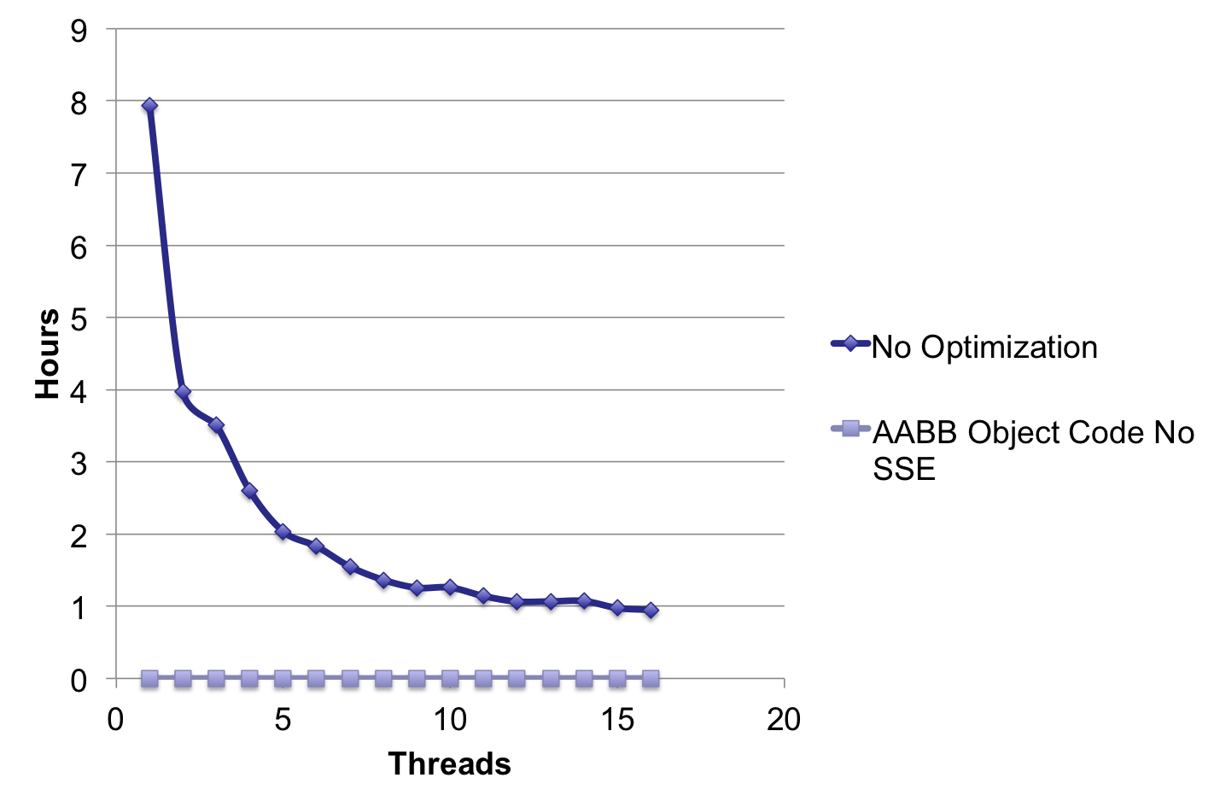
OpenMP Scale with AABB tree
The importance of choosing the right algorithm…

Slide 36
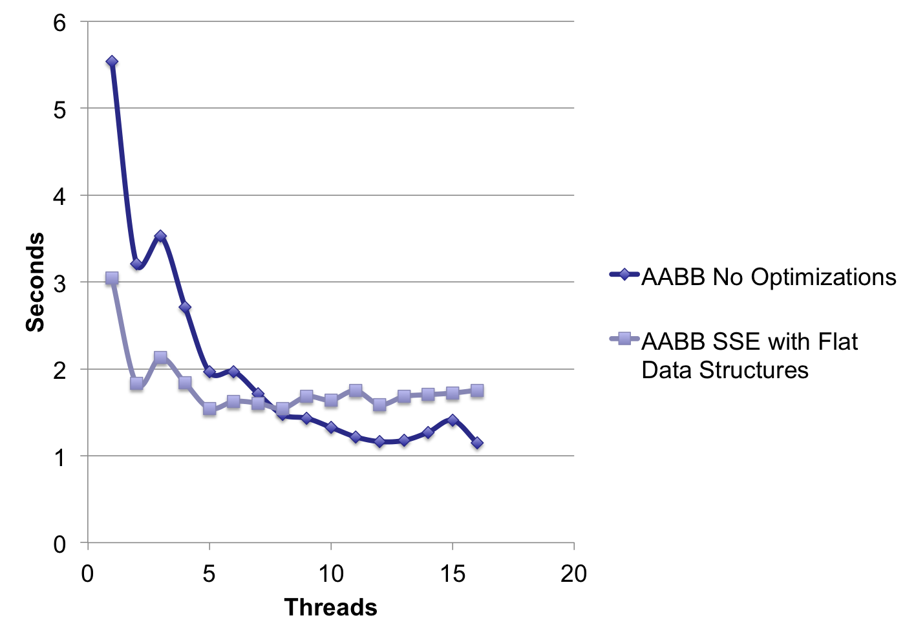
OpenMP Scale (seconds)
Merged code before benchmarking SSE code

Slide 37
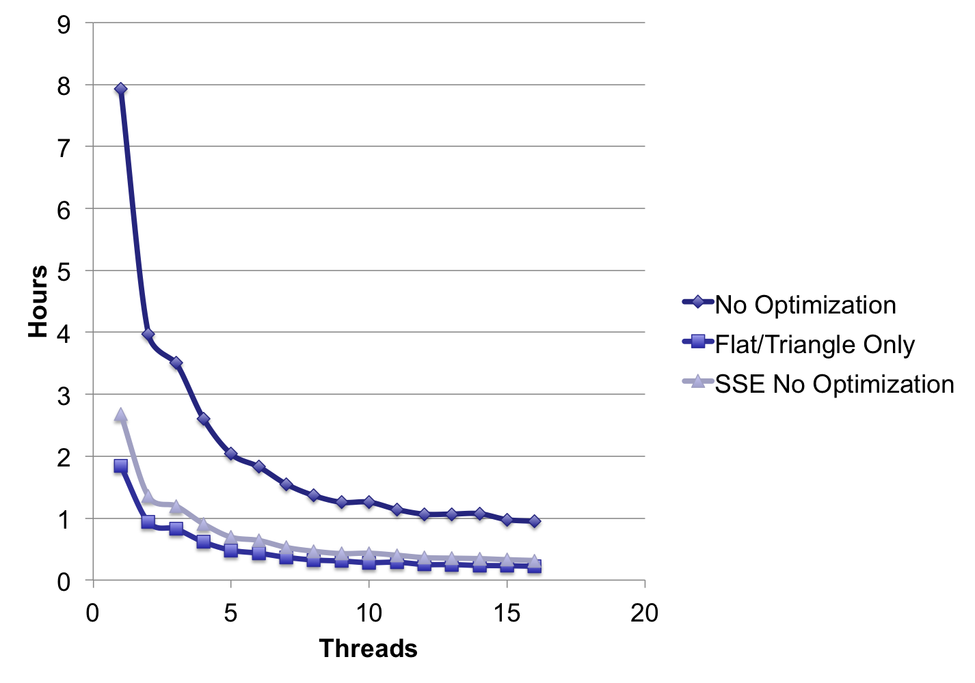
OpenMP Scale Plot

Slide 38
SSE Optimizations: Vector3Dot
Using perf to analyze SSE instructions
__m128 temp;
temp = _mm_mul_ps(v1, v2);
temp = _mm_hadd_ps(temp, temp);
temp = _mm_hadd_ps(temp, temp);
float p[4];
_mm_storeu_ps(p, temp);
Return p[0];
const int mask = 0xf1
__m128 temp = _mm_dp_ps(v1, v2, mask);
float p[4];
_mm_store_ps(p, temp);
return p[0];
_mm_hadd_ps very expensive
Vector3Dot change to only takes 40% of clock cycles

Slide 39
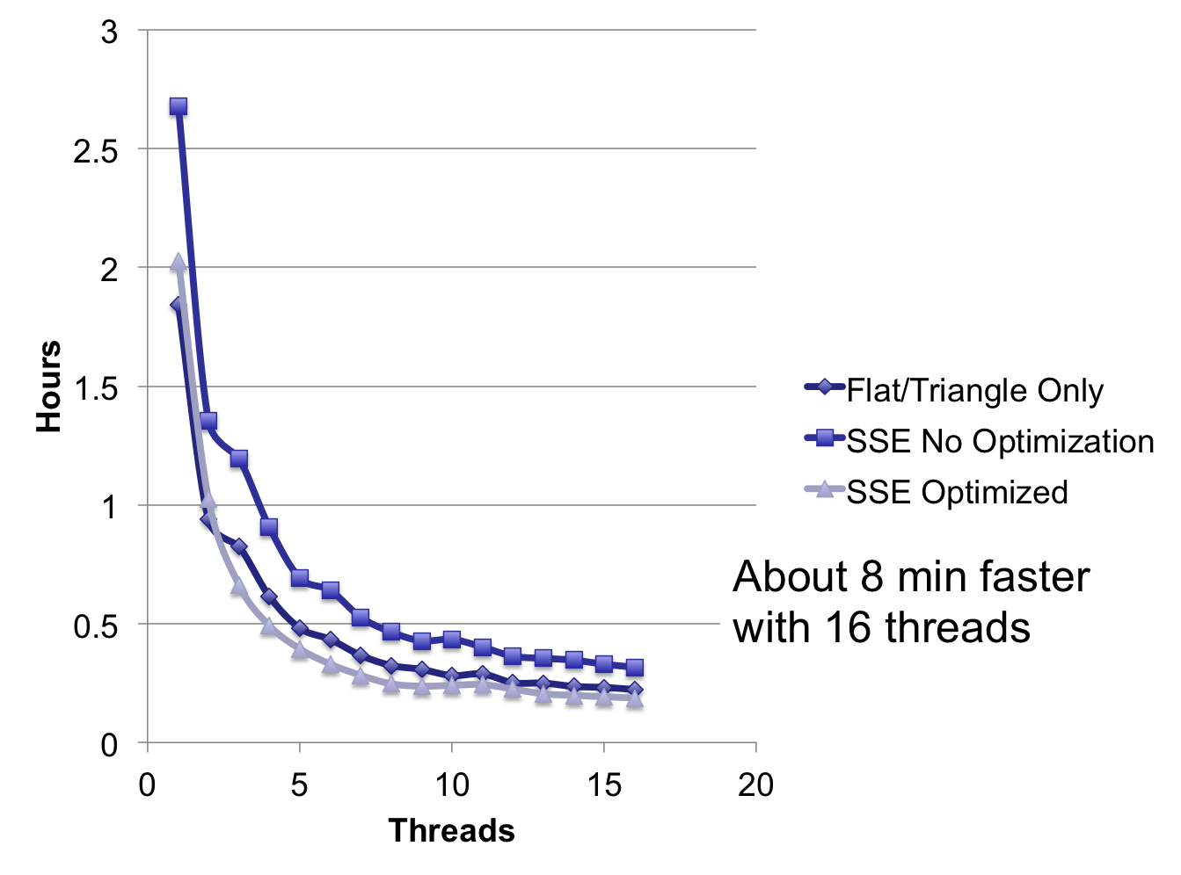
OpenMP Scale

Slide 40
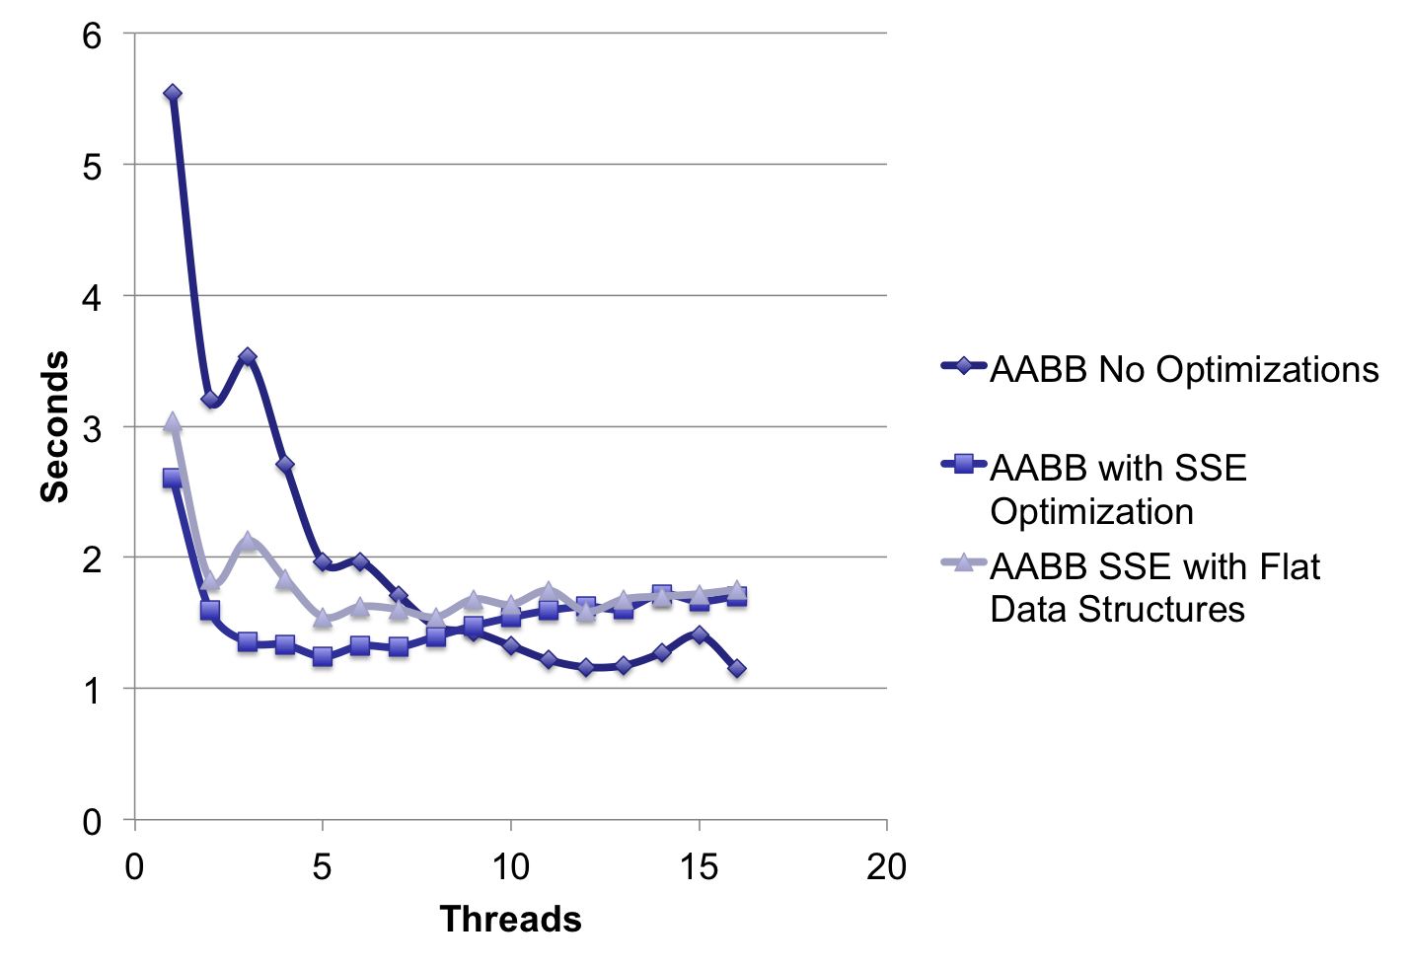
OpenMP Scale (seconds)
-Non-SSE more efficient at 8 threads
-SSE code utilized the full core more than non-SSE
-Less opportunity for other optimizations
-Perf shows major slowdown because of register overload

Slide 41
Outline
Problem and application
Algorithm
Pattern
Experiment and optimization
Final result
Future work
Conclusion

Slide 42
AABB+ SSE raytracing: Stanford Dragon in milliseconds

Slide 43
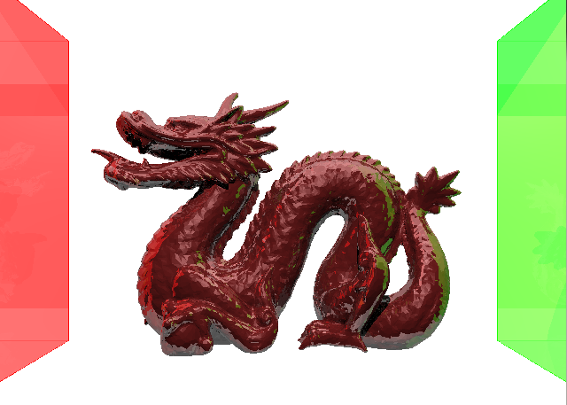
Stanford Dragon in Cornell Box

Slide 44
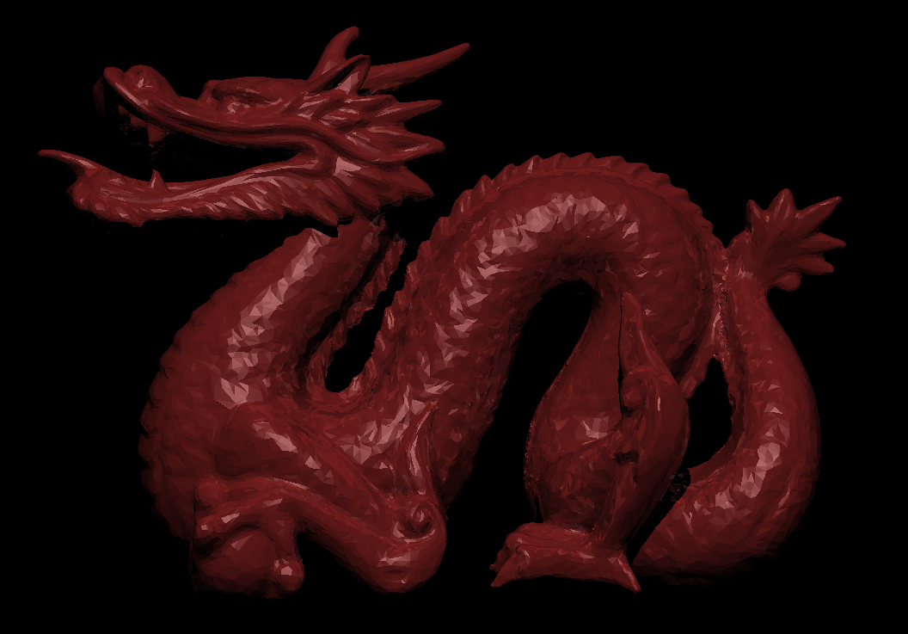

Slide 45
Result
Item | Time
Serial code | > 8Hr
OpenMP parallel for | ~ 57 min
Parallel + data in array + triangle specialty | ~ 13.4min
Parallel + AABB tree + object + triangle | ~ 1.14 sec (peak 16 threads)
Parallel + AABB tree + array + triangle + SSE | ~ 1.24 sec (peak 5 threads)

Slide 46
Result
Serial => parallel, more thread + more cache
Triangle-only program reduce branch
Data in array increase spatial locality + access speed
AABB tree reduce computation + memory access

Slide 47
Outline
Problem and application
Algorithm
Pattern
Experiment and optimization
Final result
Future work
Conclusion

Slide 48
Future work
Other algorithm to speed up intersect test
Further data align optimization
Further instruction optimization
Port to GPU
  Modify code
  Tune work group size
  Fit data into GPU memory
  Deal with tree traversal (no stack on GPU)

Slide 49
Outline
Problem and application
Algorithm
Pattern
Experiment and optimization
Final result
Future work
Conclusion

Slide 50
Conclusion
In this project
  Implement a CPU ray tracer with basic function
  Implement an AABB tree for faster computation
  Try different methods to optimize
  Basic knowledge of ray tracing on GPU

Slide 51
Q & A

Slide 52
Reference
UC Berkeley CS184/284 Slides
  Ray tracing
  BSP and AABB tree
UC Berkeley CS194 Slides
  OPL
  Optimization pattern
Wikipedia Ray tracing
http://en.wikipedia.org/wiki/Ray_tracing_%28graphics%29

Slide 53
Work
Helen Han
  Serial code
  AABB tree
Katherine Xu
  Serial code
  SSE instruction
Paden Tomasello
  OpenMP/Micro-optimizations
  Benchmark
Chien-Yu Chiou
  Serial code optimization
  Realign data storage
  Presentation slides

